Slide 1
Community Ownership and the Charlotte 2040 Comprehensive Plan:
A Community Conversation
Hosted by the Housing Justice Coalition
Notes:
Jimmy to introduce presentation

Slide 2
Housing Justice Coalition:
Who we are
The Charlotte Housing Justice Coalition is an organization dedicated to the belief, policy, and practice of Housing as a Human Right.
This commitment to housing as a fundamental right for all people informs our research, activism, advocacy, and organizing.
Policy committee
Political education
Media outreach and messaging
Notes:
Chelsea to introduce HJC

Slide 3
The Charlotte 2040 Comprehensive Plan
What is the Charlotte 2040 Comprehensive Plan?
The Charlotte 2040 Comprehensive Plan or, Charlotte 2040, is a sweeping vision that will decide how Charlotte grows for the next two decades.
It started after a conversation about updating the Unified Development Ordinance (UDO) back in 2016. The UDO sets the zoning regulations for the City. City Planner Taiwo Jaiyeoba decided then that the City needed to have a policy vision before updating its UDO.
Notes:
Ismaail

Slide 4
What does Charlotte 2040 mean for me and my community?
The adoption of Charlotte 2040, set for a vote by Charlotte City Council on June 30th, will start a process by which the City will release a draft of the new UDO, work with neighborhoods to establish “place types” and then create brand new zoning districts based off of those place types. UDO, place types and zoning districts are set for an adoption vote in early 2022.
As a result, rezonings will be much less frequent and based on how the City has designated Place Types, it will offer some level of predictability in development.
However, the creation of these zoning districts are designed so that much more development can be built “by-right” meaning that developers can build whatever they want as long as it meets the new, streamlined zoning requirements.
Notes:
Jimmy

Slide 5
If developers are able to build more “by-right,” where is the community leverage?
The Charlotte 2040 Plan, as currently written, is woefully unable to answer this question. While there are mentions of using community benefits agreements (CBAs) and “historical overlay” districts (Goal 1 and Goal 5, respectively), the City has no concrete policy plans to enact these items during the implementation process after the Plan is voted into adoption by Council.
In order for this Plan to live up to some of its aspirational goals around equity, there needs to be stronger language around CBAs specifically that allows communities a mechanism to guide development decisions and actually open up space for communities under the threat of displacement to decide how they want spaces to be developed.

Slide 6
What is a Community Benefits Agreement (CBA)?
A CBA is a private contract between a community and a developer by which the community negotiates directly with a developer to decide on what benefits the community would like to see out of the project.
CBAs can only be effective if there is popular buy-in from the community to negotiate the contract. If there is no consensus in community about a development, a community would need to consider whether to enter into CBA or work to reject the development proposal.
CBAs can include hiring and wage agreements for community, asks for grocery stores, food co-ops and community space. CBAs can even ask the developer directly for ownership of land on the site.
The City of Charlotte is using Detroit’s Community Benefits Ordinance (CBO) as a case study whereby there are districts in the City where a developer must contact a community first to enter process.
Asheville, NC recently instituted a “Public Benefits Table” into hotel development districts where hotel developers have to pick from a list of public benefits to provide to community or else undergo rezoning legislative process with the City of Asheville.

Slide 7
Why do CBAs matter?
Increasing community ownership in development
A pathway for developing more affordable housing
Creating more amenities in neighborhoods that are food deserts and lack essential goods and services
A tool for tailoring development to the needs of specific neighborhoods

Slide 8
Asheville Hotel Development District and Reparations Fund
Asheville utilizes a CBA process in the form of a Public Benefits Table for its Hotel Overlay District (Asheville UDO 7-9-7)
The Public Benefits Table lists specific conditions a developer must meet based on a points system. At least 50% of those points must come from either affordable housing or contribution to a Reparations Fund.
A newly formed Design and Review Committee is tasked with ensuring hotels built within these districts conform to the Benefits table.

Slide 9
How can we strengthen CBAs and thus community input and ownership in Charlotte 2040?
The Charlotte Community Benefits Coalition (CBC) is made up of 30+ neighborhoods and nonprofits that have asked the City of Charlotte to commission an anti-displacement stakeholder group as well as strengthen language and develop new process for CBAs.
The CBC has asked for the City to create Community Benefits Zones where each section of the city has a deliberative body of different neighborhoods that would decide collectively whether or not to pursue project.
The UDO, which is the actual regulatory tool of Charlotte 2040, would need to include provisions in zoning districts much like in Detroit and Asheville that would make certain overlay districts contingent on developers entering into CBAs.

Slide 10
Who is against CBAs and strengthening community input and ownership?
The Real Estate and Building Industry Coalition (REBIC)
Members include:
Greater Charlotte Apartment Association (GCAA)
NAIOP
Canopy Realtor Association
Greater Charlotte Homebuilders Association
Charlotte Region Commercial Board of Realtors

Slide 11
Misinformation about CBAs
Many within development lobby are claiming that CBAs are illegal. It is part of their talking points of what not to include in the 2040 Plan.
CBAs are not illegal. These are private contracts between developers and communities, etc. Example of Public Benefits Table is demonstrative of fact that they are being utilized in the state of North Carolina.
CBAs are also being utilized in Charlotte but are not referenced under that name. (ie Ballantyne redevelopment, Brooklyn redevelopment, Eastland)

Slide 12
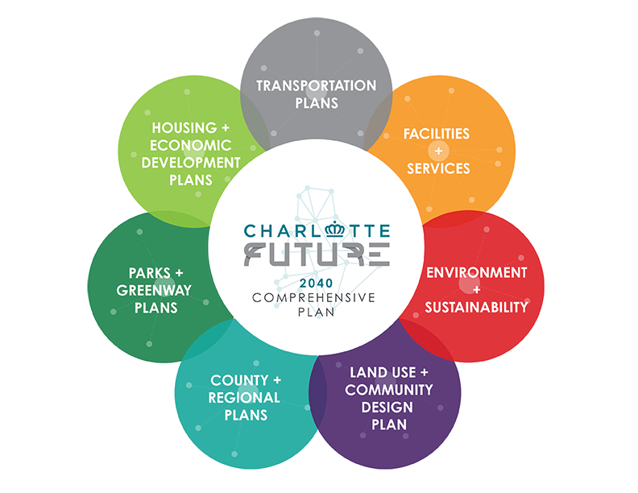
NEXT STEPS
Send Legal Memo to City Council, City Staff
Attend City’s Workforce and Economic Development Committee Meeting at 12:00 PM on 4/21/21
Attend Town Hall about CBAs on 4/22/21 at 5:30 PM
Join HJC
Join CBC
Where We’ve Been Podcast Episode

Slide 13
Q&A

